Slide 1
Exercise Book
TECHNIQUE
GAME PHASE
GAME FORM

Slide 2
Tecnico Federale
Stefano Angius

Slide 3
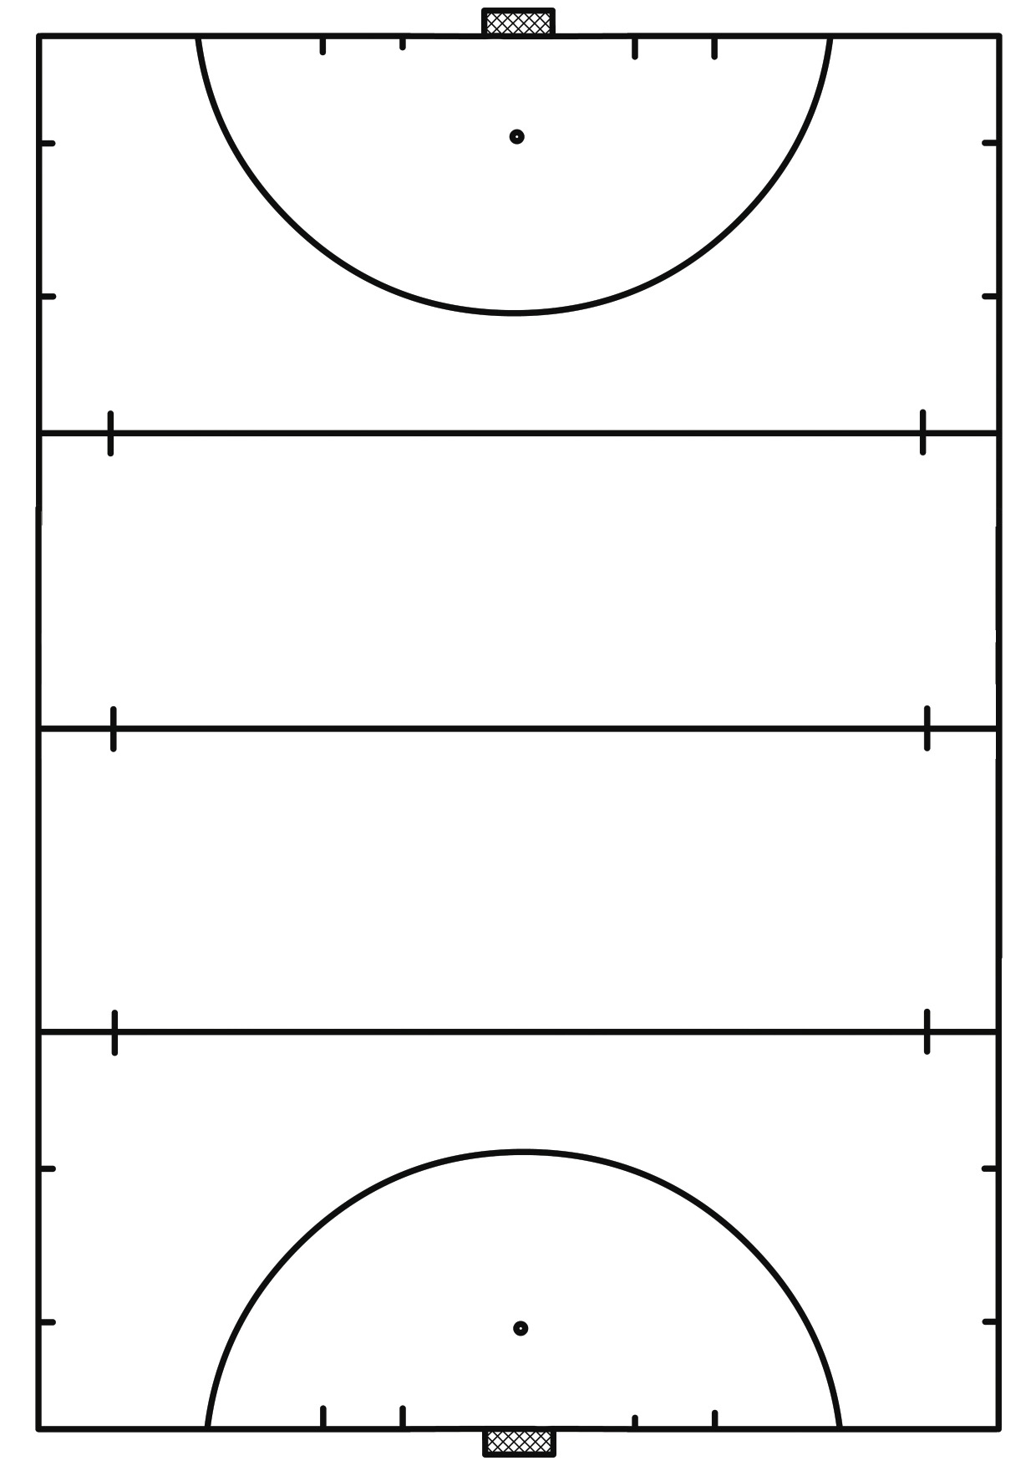
Technique
Circuito di passaggi e ricezione:
Possiamo lavorare con passaggi di push e/o strisciato.
Ricezioni: statiche, dinamiche a scappare verso sinistra e destra, offensive di dritto e di rovescio, avvolgenti (con mezzo giro/pivot).
B
2
3
1
A comincia sull’esterno destro del rombo e riceve almeno 8/10 passaggi da ciascun compagno, poi cambia l’uomo in centro.
Le varianti sono i diversi tipi di ricezione e la posizione di partenza del giocatore in centro (cambiando il cono di partenza, cambiano i movimenti e le ricezioni.
A
4
C
Regolare le distanze dei coni a seconda del livello e dell’età dei giocatori.
Stefano Angius

Slide 4
Technique
Esercizio di passaggi, smarcamento e tiro in porta.
Svolgimento:
B viene incontro ad A, il quale gli passa la palla di push. B riceve e scarica nuovamente ad A, B esegue uno smarcamento con un movimento a “C” per ricevere verso l’area il passaggio di A (che può eseguirlo di push frontale o strisciato) e concludere in porta.
Prima una fila e poi l’altra.
Le distanze sono da regolare in base all’età o al livello.
Scegliere tra le varie tecniche di tiro.
Variante 1:
B esegue un movimento di smarcamento ad “S” o a doppia “S” o direttamente in diagonale.
Variante 2:
B dopo il tiro rimane in area per allargare la porta per il tiro della fila opposta.
Variante 3:
Aggiungere un dribbling dopo la ricezione di B fuori area.
B
A
Stefano Angius

Slide 5
Technique
Circuito di ricezioni dinamiche a scappare + push + tiro in porta.
Svolgimento: A passa a B che scappa verso sinistra e passa a C che esegue lo stesso movimento e passa a D che scappa a sinistra e tira in porta.
Distanze e persone coinvolte in base all’età, al livello e alla quantità di giocatori. Variare le tecniche di tiro in porta.
Si può eseguire in contemporanea anche dall’altro lato, oppure farlo nell’altra area (con ricezioni verso destra).
Variante 1:
B, C, D, partono da dietro il cono e per ricevere la palla devono anticipare e poi scappare.
Variante 2:
Aggiungere dribbling e/o sollevamenti dopo la ricezione dinamica.
D
C
B
A
Stefano Angius

Slide 6
Technique
Es. 1
A parte in dribbling o in conduzione, davanti ai primi tre coni esegue una finta, davanti al secondo gruppo di coni fa un’altra finta e poi passa la palla a B di push o strisciato.
L’esercizio può partire in contemporanea da entrambi i fronti.
Varianti: Cambiare le finte davanti ai coni:
Finte di corpo, finte larghe di bastone, agganciare la pallina e girare, sollevamenti.
B
Es. 1
A
Es. 2
I giocatori partono in conduzione o dribbling in contemporanea e davanti ai coni eseguono delle finte.
Variare le fine: di corpo, con sollevamenti, con aggancio e giro, ecc.
Es. 2
Stefano Angius

Slide 7
Technique
B
A e B si scambiano la pallina in contemporanea e poi partono in dribbling o in conduzione, davanti ai tre coni rispettivamente sulla loro destra ed eseguono una finta e poi passano la palla di push o strisciato a chi aspetta in fila.
Varianti: Cambiare le finte davanti ai coni:
Finte di corpo, finte larghe di bastone, agganciare la pallina e girare, sollevamenti.
A
Stefano Angius

Slide 8
Technique
6
Give & go, ricezioni aperte, smarcamento e tiro in porta.
Circuito di passaggi e ricezioni. Dove passo vado (give & go).
Curare la posizione del corpo e dei piedi nelle ricezioni aperte.
A secondo del livello e dell’età dare obiettivi di ritmo e/o tocchi.
Passaggi di push e/o strisciato.
Variante:
Eseguire l’esercizio nell’altro verso.
Nell’ultima stazione, oltre al movimento di smarcamento inserire un dribbling/sollevamento.
1
5
2
4
3
Stefano Angius

Slide 9
Technique
5
Circuito di passaggi + ricezioni + conduzione/dribbling + tiro + cross + deviazioni
Svolgimento:
A passa a B e corre in verticale verso i tre coni, dove riceve il passaggio di B ed effettua un ricezione con sollevamento e tira in porta, nel mentre C parte in conduzione da destra e appena superato l’ultimo cono crossa in area per A che va a deviare. Usare push, strisciato/hit.
Subito dopo parte la squadra blu (B-D). Secondo il livello dei giocatori D può crossare anche di rovescio.
Varianti:
Variare le ricezioni davanti ai tre coni.
Inserire uno o più dribbling per C e D prima del cross.
3
2
4
A
1
B
D
C
Stefano Angius

Slide 10
Game Phase
2v0 pass & go + supporto e appoggio + tiro
A passa a B (1) e riceve il passaggio di ritorno dietro la porticina rossa (2), conduce fino ai tre coni dove esegue una finta e allarga a destra per B (3), B dopo aver ricevuto conduce fino ai coni al limite dell’area e scarica indietro (appoggio) la pallina per A che è in supporto (4), B continua la corsa per allargare la porta o cercare una deviazione, A entra in area e tira o cerca B.
Si può fare anche sull’altro lato.
Variante 1
Dopo aver acquisito i movimenti, possiamo aggiungere uno o due difensori, trasformandolo in 2v1 e 2v2
Variante 2
Dopo il passaggio (3) A continua la corsa all’esterno ricevendo la palla in ampiezza e profondità per attaccare sul fondo, B andrebbe a dare supporto a 90° o a 45°
5
4
3
2
B
1
A
Stefano Angius

Slide 11
Game Phase
3v0 pass & go + anticipo + sovrapposizioni
Svolgimento:
B passa indietro ad A (1) e comincia il movimento verso l’area, nel frattempo C anticipa i coni per ricevere il passaggio di A (2).
A dopo il passaggio a C sovrappone in area.
C dopo aver ricevuto passa a B (3) e corre in area per una deviazione.
B tira in porta (4) o crossa per A e C.
L’esercizio si può eseguire su entrambi i lati e le distanze sono in base al livello e all’età dei giocatori.
Variante 1
Le palline partono da A che esegue un doppio scambio con B, entrambi devono ricevere in movimento.
Variante 2
Aggiungere i difensori, trasformandolo in 3v1 – 3v2 – 3v3
4
C
3
2
B
1
A
Stefano Angius
Notes:
sovrapposizioni

Slide 12
Game Phase
3v0 sulla fascia con triangolazioni + pass & go
Svolgimento:
Triangolazione tra A-B-C (1-2-3), C dopo il passaggio si propone in verticale lungo linea per ricevere il passaggio da A (4).
Nel mentre D si smarca per ricevere in profondità.
C da supporto a D a 90° e A entra in area per il passaggio a 90°.
L’esercizio si conclude con un’entrata sul fondo e tiro in porta.
Da effettuare su entrambi i lati.
Varianti:
Cambiare a scelta gli obiettivi dei passaggi e delle ricezioni, creando nuovi movimenti di smarcamento, di scambi, di sovrapposizioni.
Aggiungere i difensori per creare 3v1, 3v2, 3v3
5
D
4
3
A
C
1
2
B
Stefano Angius

Slide 13
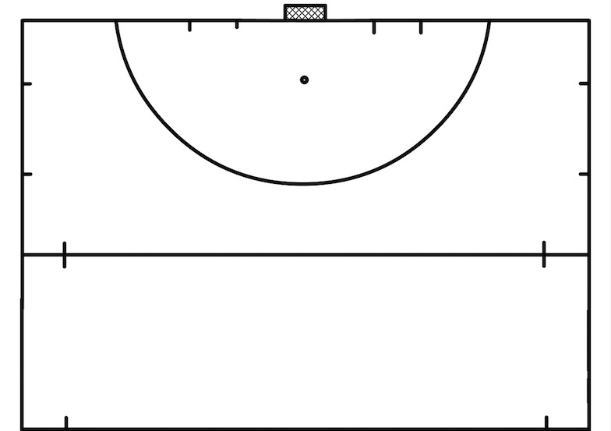
Game Phase
1v1 su un lato e poi sull’altro
Obiettivi difensore: Chiudere il centro, fronteggiare l’attaccante mandandolo all’esterno, utilizzare il jab e se possibile contrastare fuori area.
Se il difensore recupera deve uscire in conduzione fuori dai 22m.
Obiettivi attaccante: Superare l’avversario per tirare in porta, utilizzando finte di corpo e finte di bastone.
1v1 con tiro in porta
E’ una gara tra A e B.
A parte con la palla e B senza, devono transitare ciascuno su un percorso diverso, se A riesce a superare per primo la porta rossa può tirare liberamente.
Se B è più veloce proverà a recuperare la palla con un contrasto, se ci riesce diventa lui l’attaccante.
B
A
Stefano Angius

Slide 14
Game Phase
3v3 polo
Si gioca possesso palla tra le linee dei 22m con il campo più lungo che largo.
L’obiettivo è di fare gol in una delle due aree di meta delimitate dai 4 coni, solo con ricezione dentro.
Nell’area di meta può entrare solo un giocatore della squadra che attacca e nessuno di chi difende.
Quando una squadra segna in un’area di meta mantiene il possesso palla e cambia subito lato di attacco.
Importante è giocare su tre dimensioni diverse ed un attaccante sempre in profondità.
Variante:
E’ valido utilizzare il flick per segnare da un’area di meta all’altra.
Stefano Angius

Slide 15
Game Phase
3v3 a 4 porte
L’obiettivo è quello di stimolare il gioco in ampiezza ed il cambio del peso del gioco.
Il gol vale in conduzione.
Variante 1
Il gol è valido anche con passaggio dietro le porte.
Variante 2
Un giocatore per squadra rimane obbligatoriamente in profondità dietro la linea delle porte.
Variante 3
Aggiungere o diminuire i giocatori ed eventualmente cambiare anche gli spazi. Si possono creare diverse varianti di giochi, come 4v3, 4v4, 5v4, 5v5 e così via.
Stefano Angius

Slide 16
Game Phase
3v3 su un lato
L’allenatore o un altro giocatore cominciano il gioco con un passaggio su un lato e parte il 3v3.
Importanti i vari concetti tattici che si vogliono allenare ad esempio attaccare in ampiezza e in profondità, e per i difensori marcatura a zona o a uomo.
Dare un obiettivo alla difesa se recupera la palla, come ad esempio uscire con palla controllata da una determinata zona, fare un certo numero di passaggi, uscire dal lato opposto all’attacco ecc.
Varianti:
Cambiare le posizioni di partenza degli attaccanti e dei difensori a seconda dei propri obiettivi tattici.
Lavorando in questi settori si può allenare anche queste situazioni:
3v1, 3v2, 4v3, 4v4.
Ed anche situazioni dove gli attaccanti sono in inferiorità numerica come:
2v3 e 3v4
C
Stefano Angius

Slide 17
Game Phase
Costruzione dalla rimessa
2v3 con la difesa blu che ha l’obiettivo di uscire dal blocco con gol nella porta a metà campo.
A seconda del livello e degli obiettivi tattici cambiare le posizioni di partenza dei difensori e degli attaccanti.
Varianti:
3v3, 3v4, 4v4
Stefano Angius

Slide 18
Game Form
Costruzione del gioco da 4 a 3 con il terzino destro
Esempio di costruzione con un minimo di opposizione (3v7).
Posizioni, concetti e passaggi sono in base alle proprie idee tattiche.
Creare anche le seguenti situazioni:
4v7, 5v7, 6v7, 7v7
5
4
2
3
1
Stefano Angius

Slide 19
Game Form
Gioco a campo ridotto 8v8
A seconda del campo creare giochi di 4v4, 5v5, 6v6, 7v7,9v9
Stefano Angius

Slide 20
Tecnico Federale
Nicola Giorgi

Slide 21
Simbologia
coni
Team Blue
Team Yellow
Team Orange
C
Coach
Ball

Slide 22
TECHNIQUE
Cat and Mouse
The blue player must guide the ball around the square while the yellow runs without the ball trying to take him
Run, feints and frontal pass
Blue player must run with the ball and make 2 feints on the cones and doing a frontal pass to the Yellow player
Nicole Giorgi

Slide 23
Indian dribbling
The blue and yellow start simultaneously , 2 dribbling , exchanging the ball and go to the next station
Run, Pass and Receive
Blue starts with the ball and the yellow runs simultaneously , arrived at the cones the blue passes the ball to the yellow which continues its run
Nicole Giorgi

Slide 24
Pass and Run
Blue leads, then it makes a feint and passes the ball to the yellow that moves, in the meantime blue take a ball and performs a shot, then he turns around and deflect from yellow
Pass throw the goals
3 Blues in a square with 3 goals, 30 seconds to score more points as possibile passing the ball throw the goals
Nicole Giorgi

Slide 25
30 Seconds game
Each players with a ball, 30 seconds from the start to score more points as possible running throw the goals.
Run, Feints and Shoot
Run with ball, making feints on each cones and run again to shoot
Nicole Giorgi

Slide 26
GAME PHASE
Build Up 4-3-3
Build Up 3-4-3
Nicole Giorgi

Slide 27
Build Up 3-4-3 Switch
Attackers movements
Nicole Giorgi

Slide 28
In-Out Right
Nicole Giorgi

Slide 29
In-Out Left
Nicole Giorgi

Slide 30
GAME FORM
3Vs3 with a closed central square
Ball Possession with a closed space in the middle of the pitch
4Vs4 – 1Vs1
Ball Possession 4Vs4, each player must stay in his own square.
Nicole Giorgi

Slide 31
6 Vs 6 with inverted goal
Blue team must score in the inverted goal shooting from everywhere, the yellow team score in the normal goal
6 Vs 5 – 6 Vs 6
Blue team start attacking from left 6 against 5, if yellows keeps the ball have to change side and score on the blue goal on the middle line
Nicole Giorgi

Slide 32
4 Vs 4 and 1Vs1
Blue team start with the ball, after 5 passes they can pass the ball to the blue striker who will play a 1vs1 to score
1Vs0 2Vs1 3Vs2 4Vs3 5Vs4 6Vs5
A Blue Player start attacking against yellow goalkeeper, 8 seconds to score and after 2 yellows starts a 2 against 1, 8 seconds more and 2 blue will start again, so the game continues
Nicole Giorgi

Slide 33
Tecnico Federale
Carolina Pelazza

Slide 34
TECHNIQUE
1. OCCUPY THE SQUARE
We do many squares based on the number of players. We must always have a square in less than the number of players. The players lead the ball with various types of skills around the square. When the coach whistles they have to go each one to occupy a square (in each square can stay only one player). The player who occupies no square is eliminated from the game and the exercise continues removing one square and rebuilding players lead the ball.
2. IN & OUT
We have two square, one bigger yellow and another red inside the yellow one. In the red square there are two or more defenders. Outside the yellow square blu players lead the ball. To score, the blu players must to go inside the red square leading the ball and they have to go out without the defenders take them the ball.
Carolina Pelazza

Slide 35
3. SKILLS MIX
Player 1 starts leading the ball, makes a round on himself to cover the ball and passes it to player 2 who receives in movement and blows up the ball on the cones. Then he passes in the goal to player 1, who rereives, leads the ball until the cone and passes with a backhand shot in the D to player 2 who stops the ball and shots in the goal.
1
2
4. SKILLS MIX 2
Player 2 passes the ball to player 1 who runs to the ball, takes it, makes a fake and leads this until the last cone. Then passes tha ball to player 3 who goes to the D’s border, receives and shots in the goal.
3
2
1
Carolina Pelazza

Slide 36
GAME FORM
5. 3 TEAMS IN A MATCH
There are 3 teams, each one with a goal and a goalkeeper. Each team has to defend his goal but can score to other two goals. There is a player (the red one) who plays always with the team with the ball.
6. 4 vs 4
There are two teams: one player of each team has to play behind a line. The teams to score have to pass the ball to these two player. Who passes the ball to the player behind the line, changes position with him.
Carolina Pelazza

Slide 37
GAME PHASE
7. DIFENSE MIRROR
There are two difenses of four player each ones. The aim of the exercise is passing the ball in one of three goals in the middle of the field to the other difense. There are two player who have to close the goals moving from left to right and from right to left.
Carolina Pelazza

Slide 38
7b. VARIATION: LEAVING FROM DIFENSE + 3 vs 2
Leaving from defense with the aim to pass the ball in one of three goals. Two players defend the three goals. When the forwards take the ball, they play 3 against 2 defenders to go to score in the goal.
Carolina Pelazza

Slide 39
8. LEAVING FROM DEFENSE + 3vs2
Leaving from defense to pass the ball to one of two midfielders. If the right defender doesn’t find the pass quickly, he has to return the ball back and they have to pass to left defender and restart. When one of midfielders takes the ball, he has to pass the ball to forwards before the 25 yd line and then he follows the action playing 3 forwards against 2 defenders.
Carolina Pelazza

Slide 40
Tecnico Federale
Luca Da Gai

Slide 41
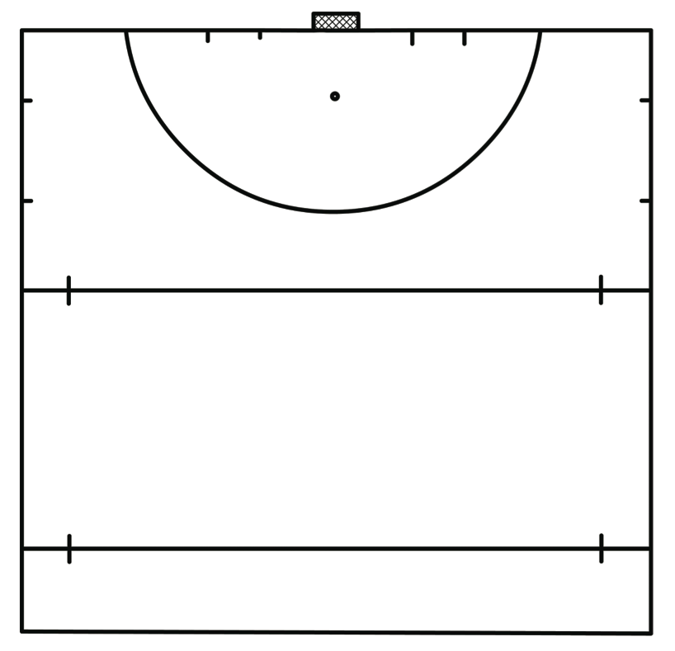
C
D
SCORE DRILL
B pass the ball to A, A to C , C again to A who scores
The same to the other side
A
B
2 GAMES
Players make a little slalom and they must make a pass (push or hit)that stops in box n1,2 or 3. each box has a point. Who make more points wins
High ball, the players must reach each box with an high ball. The player who reach each box wins
A
B
1
2
3
Luca Ga Gai

Slide 42
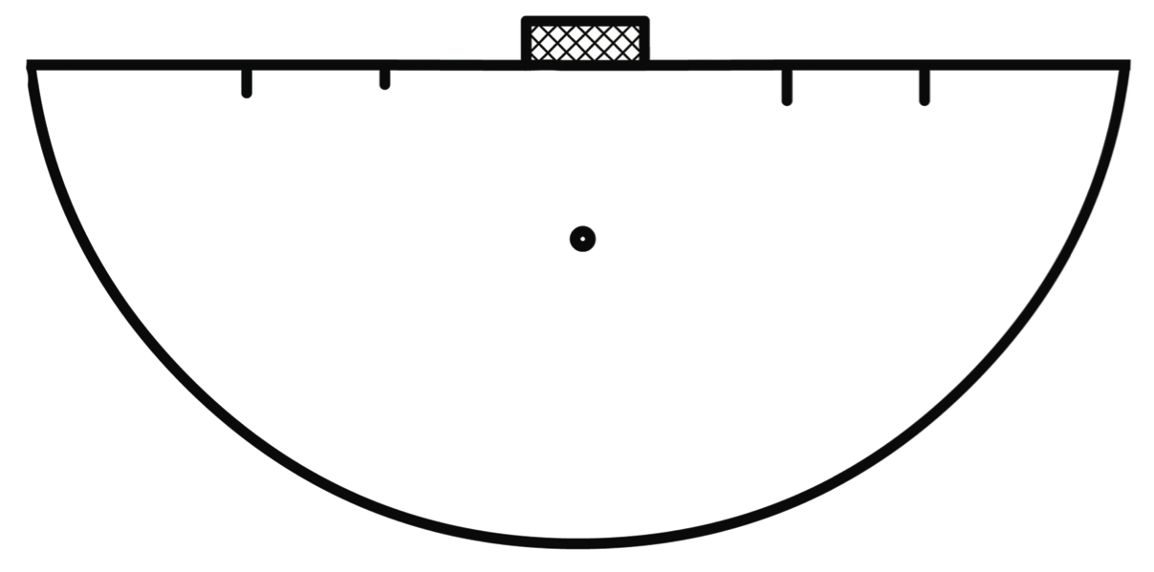
Pass drill
A run in to the box and receive a pass from b. A pass to C and goes trough.
Then b is running and he receives a pass from c, b pass to d and goes trough. Then c is running, d pass to c and c to a.
the exercise is to receive the ball from left side and with a pass and go run trough the box making a front pass.
It could be done also receiving from right side.
a
b
d
c
1vs1
Each player has a ball
The aim of each player
Is to protect his own ball and try to push away from the D the ball of other players. The last player wins
Luca Ga Gai

Slide 43
SPLIT VISION
Player A starts with slalom, when he arrived at the 23meters line starts player B,then C etc.
c
b
a
IN MOVEMENT
A start dribbling cones. He makes a pass to B.
B can decide to make a fake left ,right or lift the ball and score with forehand or backhand.
The same on the other side
A
B
Luca Ga Gai

Slide 44
Blind pass LEFT AND RIGHT
1 Player A dribbles to the center square and push out left with forehand. B idem
2 Player A dribbles to the center square and push out right with forehand. B idem (turn the upperbody)
1
2
b
b
a
a
SCORE UNDER PRESSURE
Player E pass the ball to A or C. B and D at the moment of passing start defending
Turn positions
A
C
B
D
E
Luca Ga Gai

Slide 45
POSITIONALLY
A plays the ball to B, B has to pass the line of the little goal , C must run and defend. C start from different cones
A
A
B
C
B
C
Player A and B try to pass in door 1 (2 points) or in door 2 (4 points). Defender1 and Defender2 have to prevent it
A
B
d1
d1
d2
d2
1
2
2
1
Luca Ga Gai

Slide 46
6 players: Tactical movements and passes
Defence with 3 man or 4, change positions. 2 touches , high tempo
4vs3 and 5vs4
Defense (blue) try to reach the door on midfield(left and right) and they play 4vs3
Attackers try to close and press the defence to conquist the ball and if they do it play fast with the centralforward (5vs4)
Luca Ga Gai

Slide 47
ATTACKING
A and B pass the ball each other and try to pass to E and F. D1 try to intercept the ball. E and F must make movements to reach de boxes in the same moment of the ball. they must pass the ball to C or D with a deflection or max 3 touches.
C and D after controlling the ball have to dribble and pass to the attackers before line 1 or 2. D2 has to press C or D and try to intercept.
When they pass the ball, an action starts :
Left: C-E-F and the 3 attackers vs D2 and 3 def.
Right:F-D-E and the 3 attackers vs D2 and 3 def
Change the defenders
1
D2
2
E
F
C
D1
D
A
B
Luca Ga Gai

Slide 48
3vs1 and 2vs1
3v1 five time pass in the box1, the last in ball possession move in to box 2 anda make 2vs1
2
1
2vs1
A and B plays 2:1, if Defender1 takes ball , quick pass to D2 who must score in the goal
A and B must play wide and if they lose ball . Immediatlely cover the pass to D2
D1
B
A
D2
Luca Ga Gai

Slide 49
3 vs 2
The fifth player (yellow) plays with the team in ball possession. He is never defending, always attacking .
2 goals
It call be also without goals: 1 point when you make 4 consecutive passes
3vs3 (+2 GK)
High intensity possession. quick pass, quick shot on goal.
Luca Ga Gai

Slide 50
3vs3
Game with 4 goals
1 player of each team can’t pass the line , play wide
4vs4 ; 5vs5 ; 6vs6
In a delimited part of the field two teams have the aim to mantain the possession and score points with a pass trough de goals
it’s no possible to score in the same goal
Luca Ga Gai

Slide 51
3vs1 (4vs4)
3 vs 1 the team in 3 has ball possession. They must score without that the defender touch the ball
If the defender touches the ball, possession change , two players of his team came in to attack,and the 3 players who are attacking go out and one going in to defend
4vs4
2 box 4 vs 2 defenders, if defenders take
Ball they pass in the other box and keep possession
Luca Ga Gai

Slide 52
Tecnico Federale
Andrea Lagori

Slide 53
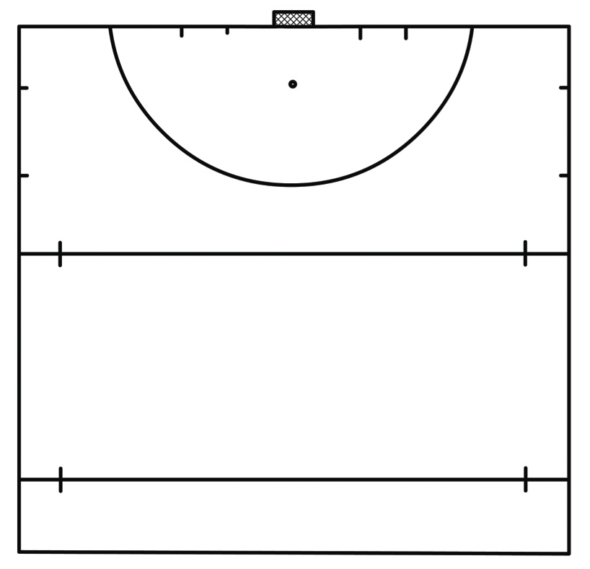
Technique
Exercise I
GK
Passages and reception on move, after slalom through the cones.
Player 1 and players 2 starts making a slalom through the cones, using indian dribble.
At the end of the cones, player 2 leave the ball and runs to receive the ball from player 1 .
Player 1 must try to pass the ball between the two cones.
After the turn player 4 will receive the ball and player 3 will pass the ball.
2
1
1
2
4
3

Slide 54
Technique
Exercise III
2
GK
1
Player 1 passes to player 2 and receives offensively and shoot on
goal, attacks the door for a deflection on the player3's cross .
The exercise is done both on the left and right side.
1
4
2
3
3
4
1
2
5

Slide 55
Technique
Exercise IV
1
2
C
3/red
3
4
Player 1 starts with a slalom between cones, at the end of
the slalom passes the ball to player 2 who by lifting the
ball pass the cones.
When the player 2 gets to the line 23 must look at the
number that the coach mark and pull the ball in that door.
the coach's signal can be both visual and sound.
Every five minutes can change the type of shot to center the small goal.
1
2

Slide 56
Technique
Exercise V
GK
Players 1 and 2 pass the ball through the cones , the player who has
possession of the ball at the end of the cones overcomes the
obstacle with a dribling and shoots on goal
2
1
1
2
GK
Exercise VI
Players go by and follow , the player at the end of the cones
overcomes the obstacle with a dribbling .
Passing and receiving must be made ​​possibly with two touches.
4
4
3
2
1

Slide 57
Technique
Exercise VII (with animation)
GK
Pass and Go
Player 4 passes the ball to the player 1 , player 3 runs to the
cones located in the middle and receives the pass from player 1 ,
player 1 runs and receives an horizontal pass by the player 3.
Player 1 runs to the D and shoots door.
The exercise is done both on the left and right side.
2
5
1
3
4

Slide 58
Game Form
Exercise VIII (with animation)
GK
Player 1 passes to player 2 that begins to move with the ball ,
the player 3 with a movement tries to distance himself from the
defender and starts a 2 vs 1 in the right corridor.
After the exercise will be repeated in the left corridor.
Can be added a defender and a striker into the D to create a 3
vs 2.

Slide 59
Game Form
Exercise IX (with animation)
GK
Players in the right corridor boarders with a 1 vs 1 , after that
go into the area and together with the players of the central
corridor starting a 2 vs 2.
In the end the exercise will become a 3 vs 3 with the use of the
players located in the left corridor.
3 vs 3
2 vs 2
1 vs 1

Slide 60
Game Form
Exercise XI
4 vs 4 with 3 teams (shortened field)
GK
The players of blue and yellow teams play 4 on 4.
When one of these teams scores, keeps the ball and attacks the opposing goal. While the team that suffered the goal leaves the field and enters the green team.
You can keep the ball at the edge of the field to keep the high pace
GK
Development
Can be used a jolly man to create numerical superiority.

Slide 61
Game Phase
GK
Exercise X (with animation)
3 vs 1 on the right side of the field.
2
Midfielder (1) passes the ball to the attacker (2), who first gets rid of the defender with a move,
the ball returns to the midfielder who passes the ball to the right wing (3).
From here begins the 3 vs 1.
1
3
Development
Can be added on defender between the line of 23 meters and the edge.
The exercise becomes 3 vs 2

Slide 62
Tecnico Federale
Martina Chirico

Slide 63
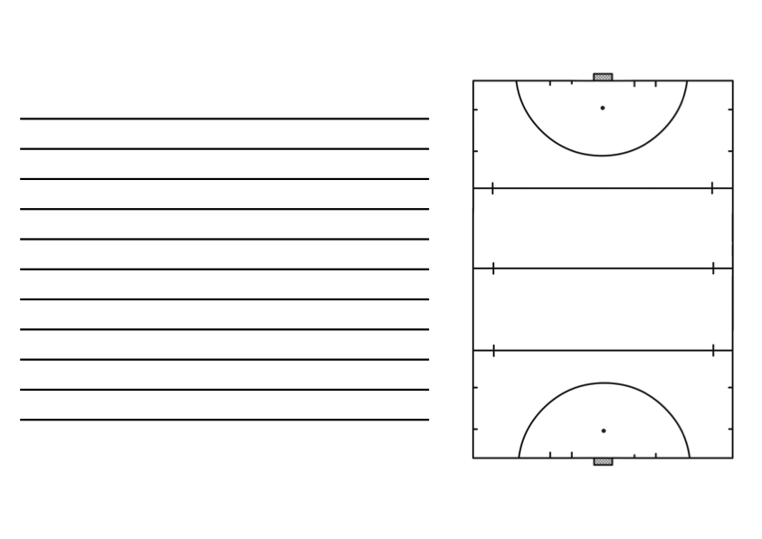
EXERCISE : technique
n #1
GOAL: dribbling with the ball , protect
and pass.
varying : make different fake every cones
Martina Chirico

Slide 64
EXERCISE : technique
n # 2
GOAL: lead the ball through the box
avoiding the obstacle.
varying : make different leading ,
only with one hand,
make fake near the
obstacle
Martina Chirico

Slide 65
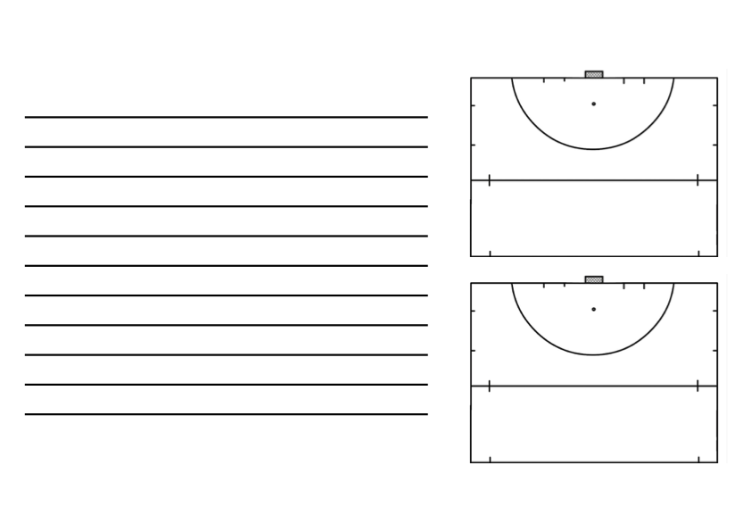
EXERCISE : technique
n# 3
GOAL: stop and pass as fast as possible.
VARYING : pass to an other person outside the box
stop with forehead and pass with back-head.
make a fake.
n#4
GOAL: stop still and pass the ball
DEVELOPMENT: one player pass and stop the ball .
The other player move to one cone to
other with a C movement. He have to stop the ball in the front (in back-head or forehead stop) and pass to him playmate
Martina Chirico

Slide 66
EXERCISE : technique
n #5
goal : pass and dribbling the cones .
Development :the players pass the ball in
swepit, receiving the ball and make indian fake ,
or a 3d dribbling to the cones , then pass the ball trough the goals.
Varying : make different fakes and different kind of passage
Martina Chirico

Slide 67
EXERCISE : technique
n#6
GOAL: pass and shoot
DEVELOPMENT: start with two ball .
1
the player who stop the first ball
have to shoot in the goal and then run to the penalty stroke .
the player who stop the second ball
have to dribbling the cons and make a passage to the penalty stroke for
his playmate
2
Martina Chirico

Slide 68
EXERCISE : technique
n#7
GOAL : pass and stop
DEVELOPMENT: the player have to stop the ball still , then move too the other cones and pass the ball on back-head shoot .
varying : make fake to the cones.
pass the ball on forehead
Martina Chirico

Slide 69
EXERCISE : technique
n #8
GOAL: stop , pass and dribbling
DEVELOPMENT: red 1 stop still the ball then dribbling.
1
the cones and pass the ball to red 2 with back-head
Martina Chirico

Slide 70
EXERCISE : technique
n#9
GOAL: pass and lead the ball.
DEVELOPMENT : red 1 lead the ball until the cones,
than pass to red2 with back-head .
1
2
red 2 stop the ball in movement
lead the ball and pass to red 3.
red 3 collecting the ball and then make fake until the D , and the n shoot
3
Martina Chirico

Slide 71
EXERCISE :GAME PHASES
n# 1
GOAL: 2vs 2 red team has to score
development : player 1 gives the ball to player 2 .
player 2 collects the ball and passes to his playmates
other ways : the player number2 addict to the attack
2
1
3
4
Martina Chirico

Slide 72
EXERCISE : Game phases
N#2
GOAL: for defender Having good passage and position
and make a deep passage
development : the four defender passes the ball with midfielder
and score to the goal
over the 23 meters line
Martina Chirico

Slide 73
EXERCISE : Game phases
N#3
GOAL : DEFENSE : DIAMOND
STRIKER : MAKE GOAL
2
DEVELOPMENT :number one pass to player number two than run to the D
1
number 2 pass to number 3 and addicted to the attack
number 3 collecting the ball and attack with the striker
3
Martina Chirico

Slide 74
EXERCISE : Game phases
N#3
GOAL : striker : make movement in to the D
defender : defending in advanced position
DEVELOPMENT: the striker outside the D passes the ball between them .
at the same time the striker in the D make movement for advance the defender
The defender have to intercept .
N#4
GOAL : make a deep passage
DEVELOPMENT :the midfield have to makes a deep passage trough the goals .
the striker collected the ball and goes to the D for score , and make 1vs1.
the defender can defend when the striker stop the ball
Martina Chirico

Slide 75
EXERCISE : Game phases
N#5
GOAL :- defense :passing as soon as in a situation of ball possession
in a situation without ball.
- strikers : score as fast as possible
DEVELOPMENT : the defender passes the ball from left
to right , then passes to the striker .
play a 3 vs 4
Martina Chirico

Slide 76
EXERCISE : Game form
N#1
NAME :rugby
meta space
DEVELOPMENT : two teams with a player in the’ meta ‘ space
for score the team have to pass the ball over the line to his teammate
the teammate in the area have to stop the ball and
then he can change with who passes to him the ball
Martina Chirico

Slide 77
EXERCISE : Game form
N#2
1
NAME : suicide
2
DEVELOPMENT : two teams , every player with a a ball standing near his goal
start player red and does a 1vs 1 with the goalie ,
then starts a blue player and make
one against one with the red who shoot ( and the red goalie ) and so on until make 4vs 4.
Martina Chirico

Slide 78
EXERCISE : Game form
N#3
NAME : 4 vs 4
1
2
GOAL : score in the two diagonals goals
DEVELOPMENT : the red team has to score in the goals number 1
the blue team has to score in goals number 2
2
1
Martina Chirico

Slide 79
EXERCISE : Game form
N#4
NAME : 6 vs 6
GOAL : the red teams has to pass to his playmate trough
the 3 goals make withthe cones , then the striker in this areas can attack the goalie , and
one player of the blu team can defense
important : for the striker , make the deep passage.
Martina Chirico

Slide 80
EXERCISE : Game form
N#5
NAME : 6vs 6 whitout the box
DEVELOPMENT : the players of two team
can cross the box only without the ball.
inside the box there is the coach with other ball
for give it to the player and make hig intensity
Martina Chirico

Slide 81
EXERCISE : Game form
N#5
NAME : americana with 3 teams
DEVELOPMENT :the black team defense , the red one attack ,
the blue standing in the goalie makes with the cones
the black teams when conquest the ball have to pass
to the blue team , who become the striker and the red one became defense .
.
N#6
NAME : one against one
DEVELOPMENT :every players have a ball and makes a one against one
with the goalie in his piece of the D
Martina Chirico

Slide 82
EXERCISE : Game form
N#7
NAME :indoor match
DEVELOPMENT :make a indoor pitch with the sides .
the ball never goes out
Martina Chirico

Slide 83
LEGEND
CONE
PLAYERS
GOALKEEPER
BALL
ARROW TO JOURNEYS
ARROW TO PASS AND SHOOTING
MOVEMENT WHIT BALL
Gabriele Bianco

Slide 84
Tecnico Federale
Gabriele Bianco

Slide 85
TECNIQUE
Development:
Player 1 takes the ball and goes to the player two with a hit sweep. Player 2 after a stop oriented passes it to 3 after an offensive reception performs a 3D and dribbling towards the goal.
Variation:
steps with hits .
1
3
2
Development: Equal to the only precedent that now runs must be made of backhead.
Gabriele Bianco

Slide 86
TECNIQUE
Development:
Player 1 runs to the second cone makes a stop offensive drove the ball straight run a 3D dribbling and towards the goal. Equal to the opposite side Players who pass the ball change every ten steps. Varied :
to add body feints or changes of direction before dribbling.
1
Development:
Double pass between player 1 and 2 and dissociation of 2 that performs the same action with the player three. open receptions backhead and hit shot. Same action on the other side with stop forehead and pull backhead
Gabriele Bianco

Slide 87
TECNIQUE
Development:
Player 1 performs 3D dribbling on the obstacles and after the first shot takes a dissociation of movement between the cones receives the ball from player 2, open stop backhead and hit shot.
Variation:
dribbling with feigned through obstacles. Same exercise done on the opposite side with stop forehead and shooting backhead.
Development:
the player turns 3 Indian dribbling , revolves around the cone and make a 3D dribbling on the obstacles going to pull or forehead or backhead.
Gabriele Bianco

Slide 88
TECNIQUE
Development:
Each player moves from his cone inside the square receives backhead and passes to push the partner who performs his own movement. After moving back to my cone. Game to play in time.
Variant:
sweep passages hit, same movement with stop forehead and pass backhead.
Development:
the yellow and the blue team are two squares placed one before the other. At the coach's signal the two teams must exchange the square with the possibility, in contrast zone, to combat and slow the opposing team. The team that with all its components comes first in the opposite square.
CONTRAST ZONE
Gabriele Bianco

Slide 89
TECNIQUE
Development:
the blue player ( striker ) with the ball takes the ball to the door. Yellow defender running towards the attacker executes a tackle-block steals the ball and leads up to the cone to his left, we turn around and passes the ball to the attacker who controls the ball and shoots towards the goal. Target: the basic teaching of the tackle-block.
Tackle block
Development:
the players with the ball keeping possession, moving freely in the square. The defender must try to steal balls and pull them out of the square. The player to whom the ball is removed is eliminated.
Gabriele Bianco

Slide 90
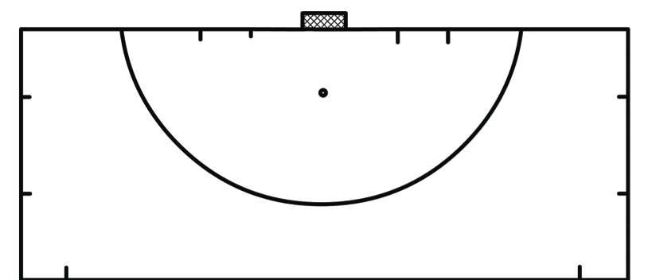
TECNIQUE
Development:
exercise taking place in the area. Two players file, move to the disk, receiving the ball and shot white a push. Who has passed then it goes to receive the ball from the opposite row, and so on.
Target: defining the goal of push.
Development:
Same as above but on goal needs to be done to reverse.
Gabriele Bianco

Slide 91
GAME PHASE
2vs1
Development:
3 square one in another queue. It starts with a 2vs1 in the first square. Who can pass the ball in the second square stops. Who does not pass the ball is added to the mate who is in the second square, and so like the last square. The last pair goes to the shooting.
Rule: there must be at least one step in each square between the two strikers .
3vs2
Development:
It starts with a passage from the yellow player in the square toward the player who is on the bottom. Here begins the 3vs2 among 3 players yellow, blue defender already area and the second which arrives late on the opposite side. Next action will start with the possession of the blue team. After every action there is rotation between the players in each team .
Gabriele Bianco

Slide 92
GAME PHASE
1 vs 1
Development:
The blue player with the ball and run to the yellow square . At the center of the square blue leaves the ball to the yellow that must turn the opposite cone and try to go to score . The blue player must in turn the opposite cone and try to defend .
5 vs 3
Development:
5 vs 3 in the area . Objective of the blue and make goals after at least one passage between them. If the defenders ( yellow ) recovering the ball should pass the ball to one of their two comrades who are outside the box into two squares. If they can come into the two yellow and two blue area ranging in the square .
C
If blues are goals the coach hands him a ball and continue to attack
Gabriele Bianco

Slide 93
GAME PHASE
5 vs 3/5 vs 4
Development:
The game starts with a throw from the blue team (or left or right) with the target to score goals in the door at the center of the field against 3 yellow defenders . If the three defenders recover the ball enter the places companions on either side of the door and attack in 5 vs 4 in the door area . Carrying out the same from the opposite side.
4 vs 4
Development:
Player 1 has the sole task of turning the ball until one of the two attackers on the sides are a passage to their companions in the area. Who passes the ball joins three for 4 vs 4. If the defense recovers aims to pass it to the player 1.
1
Gabriele Bianco

Slide 94
GAME PHASE
Goal kick
7 vs 5
Development:
The yellow team starts with a goal-kick with 's goal to enter one of the three squares in midfield places. Each square has its own score.
If the blue recover the ball attacking the door.
2 pt
3 pt
1 pt
4 vs 4
Development:
l ' exercise starts with a central player passing that after a stop in a cap and a fake on the opposite side passing the ball or to the right or left at the lateral players and here the 4 vs 4 in the area where the ball was headed. If the defenders recover goals are in conduction in one of the two side doors.
Gabriele Bianco

Slide 95
GAME PHASE
Remittance from 4 to 3
4/3
Development:
The exercise includes a goal-kick but starting from midfield to make the quick exercise. After a first ball rotation to 4 switches 3 , the full-back on the right side rooms and attaches 4 vs 4. The defender outside the box comes into play when right-back takes the ball. If the defense recovers attacks the door to midfield
Receipt in the box under pressure
Development:
The exercise starts with a passage for a player located in the central box that after receiving 3 is pressed by defenders . If you can make a transition to the companions of a 6 vs 6. If the defenders recovered the ball in the box start to turn in 6 vs 6.
Gabriele Bianco

Slide 96
GAME FORM
3 vs 3
Development:
3 teams of 3 players. A team starts to attack a defense. If the defending team recovers the ball, he passes it to a player of the third team that is placed in the outside doors. The team that received the ball attacking, attacking those who defend and those who previously defended exits.
5 vs 5
Development:
3 teams of 5 players in a narrow area between the baseline and the line of 23 m. You can shoot from anywhere on the course to hit sweep. Who will score remains in the field, those who have suffered the goal comes.
Gabriele Bianco

Slide 97
GAME FORM
5 vs 5
Development:
each one of the two teams has its own area in which to do five consecutive passes to gain 1 point ( es. yellow team field, blue field B team). The blue team , in this case, if the ball conquest must bring in her field and then begin to try to make 5 consecutive passes to gain 1 point.
A
B
8 vs 8
Development:
8 vs 8 in midfield. To attack you have to pass in one of the two side doors. variants:
you can not go in the 2 side doors so only from the central part; if you retrieve the ball in the right door area, to attack you have to enter the left door and conversely.
Gabriele Bianco

Slide 98
GAME FORM
5 vs 5
Development:
3 teams of 5 players.
L' exercise begins with an attacking team, one that defends and one behind the two doors put to the sides of the field. If the defending team recovers the ball has to go to the third team in one of the two side doors. The team receiving the ball before attacking has to jars the ball the other way. The team that was attacking now defends.
5 vs 5
Development:
4 vs 4 in a central square between the 23 m line and the midfield, plus one player per team in the area. After 3 consecutive passes inside the square, the team in possession may attack the door exiting the side areas with a passage. At this point we add 2 players in the area and become a 5 vs 5 at the door.
Gabriele Bianco

Slide 99
Tecnico Federale
Roberta Lilliu

Slide 100
Technique
N°1
DEVELOPMENT:
All four players start with the ball coming into the square with the right sides each of them trying to go in the opposite cone trying to keep control of the ball and avoiding colliding with each other
N°2
DEVELOPMENT:
The player conducts the lifting ball inside the ladder then continues with a slalom between the cones at the end of which towards the goal with straight or reverse drive.

Slide 101
Technique
N°1
Sviluppo:
Tutti e quattro i giocatori partono con la palla entrando dentro il quadrato con il dritto ognuno di loro cerca di andare nel cono opposto cercando di mantenere il controllo della palla ed evitando di scontrarsi gli uni con gli altri
N°2
Sviluppo:
Conduzione di dritto con sollevamenti palla dentro la scaletta slalom tra i coni se si esce da dx tiro in porta di drive di dritto se si esce dai coni sulla sx si tira in porta con drive di rovescio.

Slide 102
Technique
N°3
DEVELOPMENT:
The player runs with the ball towards the cones makes fakes with changes of direction and with cutouts back, past the third row of cones makes a backhand pass to the partner who has made the same movement without the ball which receives and takes in drive leads straight . Players start alternating once on the right with the ball and left when the passage you receive from right to left on goal is a reverse drive
N°4
DEVELOPMENT:
The player begins to lead the ball after a fake looks up and passes the ball to the player who starts from the red cone to get going to meet , he received the ball look where goes the companion to pass it , which receives and shoot at goal
1

Slide 103
Tecnica
N°3
Sviluppo:
Il giocatore con palla corre con la palla verso i coni fa delle finte con cambi di direzione e con ritagli indietro, superata la terza fila di coni effettua un passaggio di rovescio al compagno che ha fatto gli stessi movimenti senza palla il quale riceve e tira in porta di drive di dritto. I giocatori partono alternati con la palla una volta a dx e una a sx quando il passaggio si riceve da dx verso sx il tiro in porta è un drive di rovescio
N°4
Sviluppo:
Il giocatore con palla parte in conduzione dopo aver fatto una finta alza la testa e passa la palla al giocatore che parte dal cono rosso per ricevere andando incontro, ricevuta la palla guarda dove va il compagno per passargliela, il quale riceve e tirare in porta
1

Slide 104
Game form
N°1
DEVELOPMENT:
The player with the ball at the start of the coach runs to run around the square trying not to get caught by the opponent chasing it , after the first round the player can choose when to enter inside the square to play a 1 vs. 1 towards his opponent , who scores a goal starts with the ball
C
C
N°2
DEVELOPMENT:
Variation: the two players pass the ball outside the square with a push to reverse running from one cone to pass and receive , but at the coach's signal enter inside the square playing a 1v1 . Repeat the exercise with the passage of push straight
C
C

Slide 105
Game form
N°1
Sviluppo:
Il giocatore con la palla al via del coach corre in conduzione intorno al quadrato cercando di non farsi prendere dall’avversario che lo insegue, dopo il primo giro può scegliere quando entrare dentro il quadrato per giocare un 1 vs 1 verso il suo inseguitore, chi fa goal inizia con la palla
C
C
N°2
Sviluppo:
Variante: i due giocatori si passano la palla all’esterno del quadrato con un push di rovescio correndo da un cono all’altro per passare e ricevere,ma al segnale del coach entrano dentro il quadrato giocando un 1vs1. Ripetere l’esercizio con passaggio di push di dritto
C
C

Slide 106
Game form
N°3
DEVELOPMENT:
1 vs 2 defense works on the channeling side . the exercise is from both sides The red player starts with the ball and the first player yellow channels the red towards the block of teammate
C
C
N°4
DEVELOPMENT:
the yellow team plays a 3 vs 2 against the blue players the ball is put into play by the partner who is off the field that once passed the ball comes into play for the 3 vs 2. After the blue action will play a 3VS 2 against the red team who then will start in a 3 vs 2 against the yellow team and so on , alternating at the end of the action ( the action is considered finished after a goal or if the ball goes out on the bottom )

Slide 107
Game form
N°3
Sviluppo:
1 vs 2 la difesa lavora la canalizzazione sui laterali
da entarmbi i lati
Il giocatore rosso parte con la palla e il primo giocatore giallo canalizza il rosso verso il blocco del compagno di squadra
C
C
N°4
Sviluppo:
la squadra gialla gioca un 3 vs 2 contro i giocatori blu la palla viene messa in gioco dal compagno che è fuori dal campo che una volta passata la palla entra in gioco per il 3 vs 2. Finita l’azione i blu giocheranno un 3vs 2 contro la squadra rossa che poi partirà in un 3 vs 2 contro la squadra gialla e via così alternandosi al termine dell’azione (l’azione si considera finita a seguito di un goal o se la palla esce sul fondo)

Slide 108
Game phase
Sviluppo:
La squadra gialla gira la palla per l’uscita dalla rimessa, inizia con l’uscita a 3 cercando di creare gli spazi per i passaggi e uscire dalla pressione dell’attacco. La palla deve essere passata ai mediani dietro una delle tre porte se la palla dietro la porta la riceve il compagno si esce dalla rimessa passando da 3 a 4 se la riceve il blu la passa ai compagni che attaccano 4 vs 3
The yellow team turn the ball to building up the exit to three, they try to create space for passage to getting out of the pression. The ball must be passed to the midfielder behind one of the three doors.
If the ball is received from the companion, the exit will be changed with building up from 3 to 4. If the ball is received from the blue player,he will begin the attack of the blue team
Development:

Slide 109
Game phase
Sviluppo:
9
1
La squadra gialla attacca. Il difensore dx passa la palla al difensore sx, il quale passa la palla al mediano(2) che fa un movimento per ricevere esterno, nel frattempo l’attaccante(9) esce dall’area per ricevere il passaggio del mediano, ricevuta la palla cerca di passare la palla ai due attaccanti(1,7) e al centrocampista(5) che fanno dei movimenti per liberarsi e ricevere palla, mentre la squadra blu lavora sulla marcatura dentro l’area per non far ricevere la palla agli avversari. L'azione si sviluppa da entrambi i lati
The yellow team is attacking . The right defender passes the ball to the left defender , who passes the ball to the median ( 2 ) making a move to get outside, in the meantime, the striker ( 9 ) leaves the area to receive the passage of the median , received the ball He tries to pass the ball to the two strikers ( 1.7 ) or midfielder ( 5 ) they doing movements to get free for receive the ball , while the blue team works on marking inside the area so as not to get the ball to the opponents . The action develops on both sides
7
2
5
Development:

Slide 110
Technique
Pass and move
- The player with the ball start with a straight run and pass to the players positioned in the different goals.
Pass and move 2
3 players run straight to the goal and pass the ball each others changing direction of the passes

Slide 111
Tecnico Federale
Luciano Bazzoni

Slide 112
Technique
Dribble drill
- A player start conducing the ball, the first stage is rappresented by a teammate holding a rope ad trying to touch the ball of the attacker. The second stage is a space fullfiled of cones disposed in a random orde, the player has to dribble without touch any cone and shoot to the goal.
Pass and receive
- The drill start with a pass to the player in the front, the receiver has to move to the ball, receive with a protective profile and turn around the cones. After thet, he pass the ball to the teammate that repeat the sequence.

Slide 113
Game Form
Dynamic 2v1
- The players in the middle of the pitch have to pass and receive the ball from the teammates that are outside the pitch;
- If the pass from the outside is received by the player in the center, the outside player can enter in the pitch and move free.
When all the teammates are in the pitch, the team can score to the goal.
Dynamic 3v2
The game is based on a 3v2 situation, when a team score a goal or the ball or outside the goal side the defending team have to pass the ball to a teammate that enter in the game.
The team that was attacking has to defend, the player that shoot to the goal can’t continue the game

Slide 114
Game Form
1v1
- 1v1 game with 2 goals each defender, the goal scored in the right goal of the defender give 1 point to the attacker, the goal scored in the left goal gives 2 points.
- When the attacker scores a goal, a player of the opposite team can start and attack to score in the goals, the last attacker have to try to run back and tackle.
2v1
The players into the box has to play a 1v1 situation, the layers outside the box can help the attacker.
Passes of the attacker gives 1 point, a difensive tackle gives 2 point to the defender.

Slide 115
Game Form
2v1
- The attackers have to play two 2v1 in a consecutive order and shoot to the goal;
The defender can’t play outside the squares;
3v3 game
IN a smaller side pitch 2 teams formed by 3 players play with common rules;
The attackers can score from all the pitch;
Every game during 4 minutes, the team that wins stay in the pitch.
gk
gk

Slide 116
Game Phase
Building up/Defending press (5v4)
The defenders have to build up the attacking phase and try to keep the possession of the ball;
The attackers have to close up the action, when the player in the middle call the pressure, he can enter in the game;
If the attacker take the possession, they have to try to score in the goal.
Attacking on the right (3v3)
The ball starts in the central square, when the player pass to the teammate in the right, all the attackers and defenders can enter in the D;
The attacker in the right has to enter in the D as fast as possible and look for passes or offensive solutions.

Slide 117
Tecnico Federale
Marta Ruffi

Slide 118
TECNIQUE
Marta Ruffi

Slide 119
TECNIQUE
EXERCISE N°1
A pass the ball to B, C run whitout the ball, receives from b and pass to A.
A shoots.
SKILL ACQUISITION:
- Reception in the running
- Movement without the ball
B
A
C
Marta Ruffi

Slide 120
TECNIQUE
EXERCISE N°2
A runs with the ball between the cones , dribble the black line and passes the ball to B.
B part behind the cones , runs to the ball , gets from A and shoots the goal
SKILL ACQUISITION
Running with the ball
Dribbling
Passing accuracy
Offensive reception
B
A
Marta Ruffi

Slide 121
TECNIQUE
EXERCISE N°3
Two cones files .
The row A runs with the ball around the cones , makes a 360 ° turn around the cones near the shooting and shoots the reverse hit.
The row B runs with the ball around the cones , dribble and shoot the drive
SKILL ACQUISITION
Dribbling
Drive
Reverse Hit
A
B
Marta Ruffi

Slide 122
TECNIQUE
EXERCISE N°4
A start with the ball , dribble the cones and passes to B.
B runs around the cone and passes to C.
C receives the ball from B, runs into the maze of cones and shoots.
Variant:
- offensive reception
- shoot first (tiro di prima)
C
B
A
Marta Ruffi

Slide 123
TECNIQUE
A
EXERCISE N° 5
A runs around cones , jumps the black line with the ball and shoot the drive o reverse hit.
SKILL ACQUISITION
Dribbling
Ball controll
Drive
Marta Ruffi

Slide 124
TECNIQUE
EXERCISE N°6
A runs whit the ball and pass to B. B runs whitout the ball, recives in the running e pass to A.
Variant:
A runs whit the ball to the right and passes to B.
B receives left, carries the ball on his right and goes over to A.
SKILL ACQUISITION:
Offensive and defensive reception
Push
Run towards the ball
B
A
Marta Ruffi

Slide 125
TECNIQUE
EXERCISE N°7
A runs around the cones, recives pass to B and drive shoot.
C pass the ball to A and A reverse hit shoot.
SKILL ACQUISITION
Drive
Reverse hit
C
B
A
Marta Ruffi

Slide 126
TECNIQUE
EXERCISE N°8
A pass the ball to B. B recives and pass the ball to C. C recives the ball to B and pass to D. D recives the ball, runs and drive shoot.
SKILL ACQUISITION
- Offensive and defensive reception
Drive
Reverse Hit
Sweep hit
A
D
B
C
Marta Ruffi

Slide 127
TECNIQUE
EXERCISE N°9
A pass the ball to B, he recives, repass to A and makes a move without the ball to the right or left. A passes the ball where indicates B.
B receives and shoot.
SKILL ACQUISITION
Offensive and defensive reception
Passing accuracy
Movement without the ball
- Sweep hit
Drive
Reverse Hit
B
A
Marta Ruffi

Slide 128
TECNIQUE
EXERCISE N°10
A star whit the ball around the cones, dribble the line black and pass the ball to B. B recives and pass.
Variant
B recives the pass to A and shoot drive
SKILL AQUISITION
Dribbling
Jump
Push
Sweep hit
Drive
Marta Ruffi

Slide 129
GAME FORM
Marta Ruffi

Slide 130
GAME FORM
EXERCISE N°1
3vs3
A pass the ball to defender, he decides who pass. If the defenders recover the ball must go into one of three dors.
A,B and C, must go for goals.
SKILL AQUISITION
Offensive and defensive reception
Movement whitout the ball
Movement to S and C
Block Tackle, Jab Tackle, etc
Push, drive, sweep hit
Marta Ruffi

Slide 131
GAME FORM
EXERCISE N°2
7 VS 6
This is an exercise for the defenders on the goal – kick. The defenders have to go 10 passage to make a point.
The strikers must retrieve the ball and score.
Variant:
The defenders can steal the ball just using the block tackle or jab.
You can add two stikers making the defens outnumbered.
Marta Ruffi

Slide 132
GAME FORM
EXERCISE N°3
3VS1 + 2 GK
The two central strikers pass the ball and meanwhile the attacker on the left moves to the center to receive the ball . The left defender moves only when the striker moves toward the ball . Start a 3vs1 with the collaboration of the two goalkeepers. the goal of the defender is to throw the ball to the sides of the pitch.
Variant:
3vs2 + 2GK
3vs3 + 1GK
GK
GK
Marta Ruffi

Slide 133
GAME FORM
EXERCISE N°4
2VS1
The two strikers pass the ball to each other and then start for the door . The defender inside the square must try to stop them and throw the ball off the square . If he is overcome by the two strikers can no longer intervene. The second defender can only play if the first defender is exceeded .
Variant
2vs2
3vs2
2vs1 +GK
Marta Ruffi

Slide 134
GAME FORM
EXERCISE N°5
5VS5
A pass the ball to B, he that is located inside a square. Whene B receving the ball is pressed by two defenders. B out of the square and attacks the shooting area and creating a 5vs5.
Variant:
4vs5
5vs6
3vs2
B
A
Marta Ruffi

Slide 135
GAME FORM
EXERCISE N°6
4VS4
The central midfielder passes the ball on the first defender who passes it to him . As soon as the midfielder received the ball , the strikers who are outside the shot come into play , followed by the defenders . Begins the 4vs4.
Variant:
4vs3
5vs3
5vs4
5vs5
Marta Ruffi

Slide 136
GAME FORM
EXERCISE N°7
7VS6
Two teams. The team of strikers can score in both ports and may also go behind the door . The defenders can score in the front door only after 5 steps below.
Variant:
7vs7
6vs6
5vs6
SKILL AQUISITION
Breadth and depth
Movement to S and C
GK
Marta Ruffi

Slide 137
GAME FORM
EXERCISE N°8
5VS4
They can not move to the center of the pitch and the players are forced to play the sides .
Variant:
4vs4
3vs4
6vs6
5vs6
GK
Marta Ruffi

Slide 138
GAME FORM
EXERCISE N°9
5VS4
5vs4 game. Each team to attack dorvà enter and leave one of the two little doors done with cones .If the other team steals the ball will be forced to do the same procedure.
Variant:
4vs4
5vs5
6vs6
Marta Ruffi

Slide 139
GAME FORM
EXERCISE N°10
4VS4
Simple exercise. Each team to make three points will have to make 5 steps .If a team hits the ball and twice in the same action ,will remove a point to your score.
SKILL AQUISITION
Block Tackle
Jab
Push
Movement whitout ball
Marta Ruffi

Slide 140
GAME PHASE
Marta Ruffi

Slide 141
GAME PHASE
EXERCISE N°1
Two teams .Two players start at the coach's whistle and run without the ball around the cones . They come upon a group of balls positioned near the 22 meter line , take a ball head , enter in the shooting and shoot of sweep hit.
SKILL AQUISITION
Run whithout the ball
Speed of execution
Sweep hit
Ball control
Marta Ruffi

Slide 142
GAME PHASE
EXERCISE N°3
The midfielder runs without the ball towards the ball carrier , makes a C movement between the cones , receives the ball and passes to fullback . The quarterback receives the ball with a dynamic receiving and passing the ball to the striker which is deep. The striker receives the pass , the ball door for a few meters and passes it to the midfielder who in the meantime has come to the edge towards the goal.
Variant:
The defender does not pass the ball to midfield , but the full-back . the quarterback runs a few meters with the ball and pass it to the midfielder . The striker and midfielder passes towards the goal.
SKILL AQUISITION: Offensive and defensive reception, movement without ball
Marta Ruffi

Slide 143
GAME PHASE
EXERCISE N°3
The striker makes a move to C and receiving the ball whit an offensive recepition. At the same time, the defender runs whitout the ball around the central cone and tries to steal the ball striker.
Variant:
When the striker receives the ball, a difender and a striker onto the pitch.
SKILL AQUISITION
Offensive and difensive reception
Driibling and block tackle
Marta Ruffi

Slide 144
GAME PHASE
EXERCISE N°4
The striker runs out of the cones , receiving the ball with an offensive reception and towards the goal.
Variant:
Offensiv reception on the reverse and shot of reverse hit.
SKILL AQUISITION
Offensive reception
Drive, seep hit, reverse hit, push
Marta Ruffi

Slide 145
GAME PHASE
EXERCISE N°5
The striker pass the ball to the defender who then passes it to him . Begins a 1v1 . The defender can catch the ball using only the block tackle.
Variant
The defender can catch the ball only using the jab or any defensive technique.
SKILL AQUISITION
Block tackle, jab, defensive technique
Push, drive, sweep hit, reverse hit.
Reception in the running
BLOCK TACKLE
Marta Ruffi

Slide 146
GAME PHASE
EXERCISE N° 6
The midfielder part with the ball around the cones and passes the striker ball and runs close to the door , choosing what cone position to receive the ball .
The striker receives the ball , runs down to the bottom , look where is positioned the midfield and passes the ball.
Variant:
A defensive player can enter the court when the midfielder passed the ball to the striker.
Marta Ruffi

Slide 147
GAME PHASE
EXERCISE N°7
The defender passes the ball to the striker and follows striker mirror to the area with a passive defense. With this exercise, you learn to defend in front of and to follow the opponent's movements.
Variant:
The defender actively defends and recovers the ball if he can go to the shooting.
SKILL AQUISITION:
Block tackle, push, dribbling, movement to C and to S.
Marta Ruffi

Slide 148
GAME PHASE
EXERCISE N°8 FOR THE GK
Ten players are positioned on the edge of the shooting . Each player has 10 balls and one by one they pull towards the goalkeeper .
SKILL AQUISITION:
Drive, push, reverse hit, sweep hit.
Placement of the goalkeeper
GK
Marta Ruffi

Slide 149
GAME PHASE
EXERCISE N°9
Two teams . Each team must remain in his own half and must run within the field leading the ball forehand and backhand . On the coach's whistle , both teams must occupy the part of the opponent's field entering one of the two doors .
Marta Ruffi

Slide 150
Tecnico Federale
Filippo Treno

Slide 151
ESECUZIONE: A e B corrono verso la palla. Se arriva prima A la protegge e torna indietro per superare la linea di partenza. B anticipa in jab per superare la porta davanti a se.
OBIETTIVI: 1 VS 1.
DESCRIPTION: A and B run towards the ball. If A arrives first, he protects the ball and runs back to the start line. B anticipates with the jab to run towards the end line.
AIMS: 1 VS 1.
A
B
ESECUZIONE: A conduce sollevando la palla oltre gli ostacoli dopodiché scarica la palla a B per il tiro in porta.
OBIETTIVI: conduzione 3D, tiro in porta.
DESCRIPTION: A lifts the ball over the obstacles, then passes the ball to B for the shoot.
AIMS: 3D dribbling, goal scoring.
A
B
Filippo Treno

Slide 152
ESECUZIONE: A cerca di superare la , porta difesa da B. C raddoppia se necessario. Se A non riesce a tirare in porta, D entra in area in conduzione per tirare. Alternato dx / sx.
OBIETTIVI: 1 VS 2, tiro in porta.
DESCRIPTION: A trys to pass through the line protected by B. C double covers B if it’s necessary. If A can’t shot, D carries the ball in the D to score. Left/right alternation.
AIMS: 1 VS 2, goal scoring.
C
B
A
D
ESECUZIONE: A passaggio a B e si muove verso la porta, B passaggio a C per il tiro.
OBIETTIVI: spostare la palla da sx a dx, tiro in porta (C), movimento senza palla (A).
DESCRIPTION: A passes the ball to B and runs to the post, B passes the ball to C for the shoot.
AIMS: left to right pass, goal scoring (C), off-the-ball movement (A).
A
C
B
Filippo Treno

Slide 153
ESECUZIONE: A passa a B, B passa a C, C passa ad A che si è mosso senza palla per riceverla ed andare al tiro.
OBIETTIVI: passaggio, ricezione, movimento senza palla, tiro in porta.
DESCRIPTION: A passes to B, B passes to C, C passes to A who moved ahead without the ball, who receives and shoots.
AIMS: pass, stop, off-ball-movement, goal scoring.
C
B
A
ESECUZIONE: A passa verso 2, B corre in anticipo, recupera la palla e prosegue in conduzione fino a posizione 4 per ripassare ad A.
OBIETTIVI: anticipo, protezione palla, conduzione, passaggio.
DESCRIPTION: A passes to 2, B anticipates and carries the ball until position 4, then passes back to A.
AIMS: anticipation, ball protection, ball carrying, pass.
B
3
A
2
1
4
Filippo Treno

Slide 154
B
ESECUZIONE: A conduce lungo i 23 verso 1 per effettuare un drive per B che andando incontro alla palla dovrà stoppare e tirare in porta. Alternando dalla parte opposta.
OBIETTIVI: conduzione, passaggio di drive in diagonale, stop in movimento e tiro in porta.
DESCRIPTION: A carries the ball along the 23 line until position 1,then hits the ball for B , who receives and shoots. The same on the other side.
AIMS: ball carrying, diagonal hit pass, receiving in movement, goal scoring.
A
1
ESECUZIONE: passaggi frequenti in movimento fra A e B. B da posizione 1 corre verso 2 per ricevere un passaggio da A sul rovescio per entrare in area e tirare.
OBIETTIVI: passaggi in movimento, stop di rovescio, tiro in porta.
DESCRIPTION: frequent passes between A and B. B runs from 1 to 2 ,receives the ball from A on the reverse,enters the D and shoots.
AIMS : passes in movement, reverse stop, goal scoring.
2
1
B
A
Filippo Treno

Slide 155
ESECUZIONE: A passa a B, B passa a C, C conduce, supera l’ostacolo in flick e tira in porta. Alternato dx / sx.
OBIETTIVI: passaggio, stop, conduzione, tiro in porta.
DESCRIPTION: A passes to B, B passes to C, who carries the ball, lifts the ball over the obstacle and shoots. Left/right alternation. AIMS: pass, stop, ball carrying, goal scoring.
B
A
C
D
ESECUZIONE: A corre lungo la fascia dopo aver passato a B, B passa a C, C passa ad A che stoppa in movimento e conduce per poi effettuare un passaggio in profondità per D che ripassa in area a C per il tiro.
OBIETTIVI: passaggio verticale, movimento senza palla, 2 VS 1, movimento della punta.
DESCRIPTION: A passes the ball to B, then runs on the right side. B passes to C, C passes to A, who receives in movement, carries the ball and passes to D ,who stops and passes to C inside the D for the shoot.
AIMS: deep pass, off-the-ball movement, 2 VS 1, striker movement.
C
B
A
Filippo Treno

Slide 156
ESECUZIONE: A conduce entrando dentro la porta (1), passaggio slap-shot a B, scoop in diagonale sui 23 per C, C VS portiere.
OBIETTIVI: conduzione, passaggio slap-shot, scoop, 1 VS 1 con il portiere.
DESCRIPTION : A carries the ball through 1, then slap passes to B, who makes an aerial to C on the 23 line, C receives and plays an 1 VS 1 with the goalkeeper.
AIMS: ball carrying, slap pass, aerial pass, 1 VS 1 with the goalkeeper.
1
B
A
C
ESECUZIONE: A passa a B, B passa a D che conduce per effettuare un passaggio in area per C che nel frattempo si è portato in posizione.
OBIETTIVI: movimento senza palla per ricevere un passaggio.
DESCRIPTION : A passes to B, B passes to D, who carries the ball and passes inside the circle to C who ran in the position.
AIMS : off-the-ball movement to receive a pass.
B
C
A
D
Filippo Treno

Slide 157
Tecnico Federale
Elia Zorzan

Slide 158
Technical Skill
Elia Zorzan

Slide 159
Drive and pass
Description
Drive the ball from the start (yellow player) to central cone, pass the ball to the left (blue player) with push pass.
Development:
Starts to drive with a fake
Drive over an obstacle
To do a “no-look pass”
With a reverse push pass
First player (yellow player) drive ball from start to the centre and leaves ball in the centre, second player (blue player) pick the ball and go
All together starts (no collision)
Receive from frontal pass, keep the ball and pass
Elia Zorzan

Slide 160
“German Square”
Description
Pass the ball only with the near player
Development:
Free pass
Push pass
Fake pass
Slap pass
Elia Zorzan

Slide 161
“Pass and return”
Description
Blue player pass the ball and run up to yellow player, receives return pass and he do a vertical pass. Yellow player run to the circle, receive and hit on goal.
Development:
Precision hit
To score against GK
Receive from left (mirror excercise)
To do reverse hit
Aerial vertical pass
Reverse stop
Elia Zorzan

Slide 162
“Call pass and shot”
Description
Yellow player calls the ball from specific position, dinamic receiving and hit.
Development:
Only with visual contact
Yellow player shows with the stick where he wants to receive
Make a dribbling after receiving
Specific reception
Specific shot
1
2
3
Elia Zorzan

Slide 163
“Pass and go”
Description
Red player (1) pass the ball, yellow player does an open receiving and return the ball to red player, fast pass back and forth and do it the same with yellow player.
Development:
Use reverse to pass to yellow player
Do it in clockwise
1 touch return pass for red player
Different receptions for red player (1)
1
Elia Zorzan

Slide 164
“Drive, hit and deflect”
Description
Red drives with aerial dribbling, shots on goal and run in the circle to deflect.
Blue makes a fake, hit in the cirlce and go to deflect.
Yellow makes a spin and hit in the circle
Development:
Change technical skills
Change the starting order
Every player shots on goal
Elia Zorzan

Slide 165
Pick and go
Description
Yellow player goes in the box, picks up the ball with jab and drive the ball out the box.
Development:
2 players at the same time
With 2 aerial touches
As fast as possible
Team competition (determinated by time)
Elia Zorzan

Slide 166
“Make a movement and receive”
Description
Yellow pass the ball to red player, blue make a “C” movement, receives the ball and shots on goal.
Development:
Other unmarker movement (“S movement”)
Diagonal pass (not vertical pass)
Move out a block
Elia Zorzan

Slide 167
Game form
Elia Zorzan

Slide 168
In the box
Description
Play 1vs1 in the box, each player can play only his teammate.
Development:
Internal players can play witch all external players
Use more balls (to call pass from any external player)
Pass from side to side
2vs2 in the box
2vs2 (point with a pass between internal player)
1 vs 2 (point with pass from a side to the other)
Elia Zorzan

Slide 169
Sectoral attack
Description
Play 1vs1, defender stop when striker pass the circle line.
Development:
Yellow starts with ball received
Start with double pass
Best of 5 time
A match between yellow and blue
2vs1
2vs2 (defender continue in the circle)
Elia Zorzan

Slide 170
2vs1 + GK
Description
Play 2vs1, defender stop when striker pass the circle line.
Development:
Without double pass
Divide field in left/right
Start from defender hit

Slide 171
3vs2 + GK
Description
Play 3vs2, defenders works between 23 and circle, stop when striker pass the circle line.
Development:
Without double pass
Divide field in left/right
Start from defender hit
Overload from striker
1 striker starts in the circle
Elia Zorzan

Slide 172
Ball possession
Description
Play 3vs3vs3, who score in the middle goal continue the attack in the other side, who score in the external goal make a point.
Development:
With only 1 goal
1 goal with GK
4vs4
Elia Zorzan

Slide 173
Adding 1
Description
Player 1 drives the ball and makes 2vs1. After that he remains in the circle. Player 2 starts and play 2vs2. ->3vs2 ->3vs3
Development:
Starting from 2vs2
Numerical superiority for attack (starting from hit against GK)
Numerical superiority for defense
1
2
3
4
Elia Zorzan

Slide 174
Game phase
Elia Zorzan

Slide 175
4vs4 (Attack)
Description
Play 4vs4, yellow player starts the game driving the ball. Yellow players try to score or take a PC.
Development:
Start with a reception
Ball from defenders
5vs4
6vs4 (only 4 in the 23)
Elia Zorzan

Slide 176
6vs4 (Defense)
Description
Play 6vs4, yellow player starts the game driving the ball. 1 point when defenders take possession, 1 point if score to lateral goal, 3 points if drive ball through numeric goal.
Development:
6vs5
6vs6
Start from defender hit (in condition to clean under pressure)
With only lateral goal
1
2
3
Elia Zorzan

Slide 177
4vs4 (Midfielder)
Description
Play 4vs4. Score with a pass across goal or driving a ball. 2 point if score in middle goal (2)
Development:
5vs5
6vs6
1
2
3
1
2
3
Elia Zorzan

Slide 178
7vs7 (Defender and Midfielder)
Description
Play 7vs7. Every player can stay only in the own area. Play with all teamate near his area.
Development:
- Max 2 teamate in the same zone
Without horizontal line (play for all vertical area)
Without vertical line (play only for defender line or midfield line)
Elia Zorzan

